Slide 1



Slide 2
RECOGNITION
THE MESSIANIC PROPHECY BIBLE PROJECT
http://www.messianicbible.com
HEAR O ISRAEL
www.hearoisrael.org
SHEEPFOLD GLEANINGS WRITTEN BY JULIE PARKER
www.sheepfoldgleanings.com
MESSIANIC ISRAEL ALLIANCE
http://www.messianicisrael.com
AZAMRA TORAH FOR OUR TIME – RABBI AVRAHAM GREENBAUM
http://www.azamra.org

Slide 3
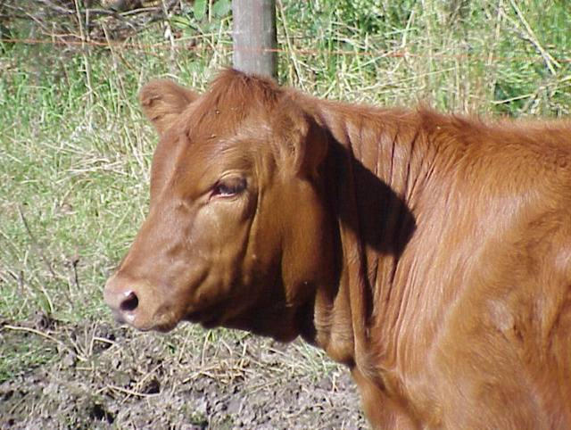
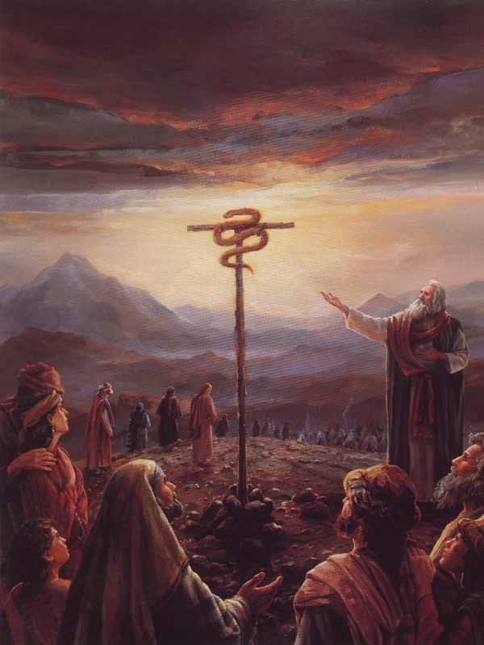
CHUKAT– “Decree”
TORAH: Numbers 19:1- 22:1
HAFTORAH: Judges 11:1-33
B’RIT CHADASHAH: Hebrews 9:11–22; 13:10–13, 1 Corinthians 10:4, John 4:10,14; 7:37, Revelation 22:17, John 3:9–21; 12:32, Luke 10:19
All references: The Scripture 1998+ unless otherwise noted

Slide 4
BEGINNING AND END
Rabbi Avraham Greenbaum points out that, “Korach's conspiracy is not explicitly dated in the Torah narrative, but is considered to have taken place early on during the wanderings of the Children of Israel in the wilderness. The Torah passes over the 38 years of wandering after the sin of the Spies in almost complete silence -- except for a list given later on of the stopping points on the journey, Numbers 33, in parsha Mas'ei. In our present parsha of Chukat, we move almost imperceptibly from the initial period in the wilderness following the Exodus and the Giving of the Torah, right to the end of the 40 years of wandering and the first stages of the conquest of the Land of Israel.”

Slide 5
DECREE OF THE RED HEIFER
Number 19:1-10 The Decree of the “Red Heifer”.
The rabbis call this the Law of the “Parah Dumah”. Which is not correct because the Torah does not present it as a law for e.g. “This is the Law of the Pesach (Pascal or Passover) Lamb”.
What the Torah says is: “This is the Decree of the Torah which יהוה commanded,….” The “Decree of the Red Heifer” is related to the whole of Torah. We must understand and follow this command especially because in verse 10 it says, “And it shall be a decree forever to the children of Yisra‟el and to the stranger who sojourns in their midst.”
According to the same rabbis, this Mitzvah is, quote, “one of the most incomprehensible of all the Laws of the Torah.” They say, “it’s one we cannot understand. But, we must obey because it comes from Elohim.”

Slide 6
THREE TYPES OF COMMANDS
“Eidot”, are commands that recall or testify to past events; like the laws regarding Shabbat or Pesach
“Mishpatim” are commands that are also dictated by mortal understanding; like honoring one’s parents or not stealing.
“Chukim” are commands that have no rational basis or explanation on the surface. Just because we might not understand the reason behind a command; we are still expected by Elohim to guard and keep it. He does not have to justify Himself to His creation.
We should want to keep even these commands because we are motivated by “kabbolat ol” (the Heavenly yoke) of Torah. But, while we are to be obedient to all of HaShem’s commands, He does desire us to understand what He’s asking of us. This is why it is important to study His Word, so that the rationale, which is at times hidden from view, will be seen. This actually helps us to internalize the Torah, as He writes it on our hearts.

Slide 7
ADAMAH PARAH “RED HEIFER”
“Parah” does translate as “heifer”, it is Strong’s #6510 and also means; “to break”, “to shatter” and so means “broken one”.
The word for “red” is Strong’s #0122 “adom / adam / adamah” and means “red”, “ruddy”, “man” and “lentils” (red lentil stew, for which Esau sold his birthright). This we have “Red Heifer” or “Man to be Broken”.
The Rabbis call this portion “Parah Dumah”. “Dumah” is a Hebrew word that means “silent” or “in silence”.
The “Red Heifer” is to be a “perfect one”. “Tamyim” Strong’s #8549, meaning; to be “perfect”, “undefiled”, “complete”. It is from the root word, #8552, “Tamam” meaning; “to be finished”.
Where have we heard, “It is finished.”? John 19:30.

Slide 8
NO BLEMISH
“in which there is no blemish…” Blemish is the Hebrew word “muwm” and is Strong’s #3971 meaning; “physical defect”, or “moral stain”,
“and on which a yoke has never come.” we normally think of yoke as “work”, or “to be worked”. The Hebrew word used here is, as we saw above, “’ol” and is Strong’s #5923 and is from #5953 “alal” meaning; “deal with severely”, to “abuse, mock, make a fool of” or thrust in. While this “Red Heifer” was to be “perfect”, without “blemish” or “moral stain” and “not abused”; the abuse would certainly come to our “Red Heifer”.
יהושע, like the Red Heifer, was killed outside the camp and His blood was shed / sprinkled toward the Dwelling Place, as He faced it.

Slide 9
WHY A COW?
Why not a ram, goat or lamb? יהוה wants us to “get it”, to understand. What Torah event best symbolizes sin in Israel?
After the Children of Israel swore to “Sh’ma” or “do and hear” all the Words of the Covenant, while Elohim was writing the Ketubah, with His own finger, what was going on in the camp? “Na’aph” in Hebrew, or adultery and idolatry with a “golden calf”.
What better symbol for cleansing here than a “red heifer”? The Hebrew phrase used in Exodus 32:4 & 8 is “masekah egged” or “molten male calf”. The Hebrew in Numbers 19:2 is “adamah parah” or “red heifer”, which is a “female calf”.
The male represents “strength”, their sin was committed in strength, with a “high hand”, a fist raised, open rebellion.
The female, represents “racham” or “mercy” and the forgiveness HaShem extends to us, as it is a female attribute of Elohim.

Slide 10
NUMBERS 19:3
‘And you shall give it to Elʽazar the priest, and he shall bring it outside the camp, and shall slaughter it before him. (Numbers 19:3)
The red heifer was to be killed outside the camp in a clean or set-apart place. That clean place was historically and biblically understood to be on a separate mountain entirely than the one the temple was on, which was Mount Moriah. The most authentic clean place outside the camp was on the Mount of Olives. This mountain, opposite Jerusalem, has historically been accepted as the scripturally sound set-apart place for the red heifer sacrifice. Also known as the Skull Mountain in יהושע’s day, the Mount of Olives has long been recognized by the Israelites down through the generations as the place where Yeshua died.

Slide 11
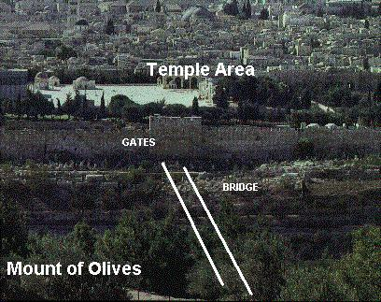
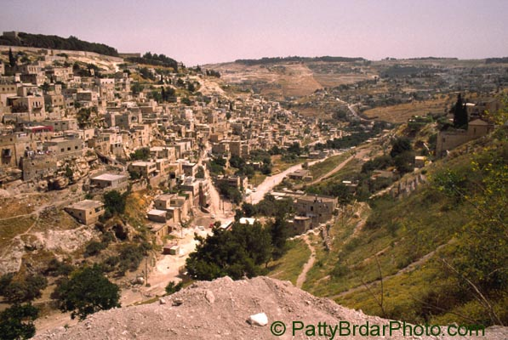
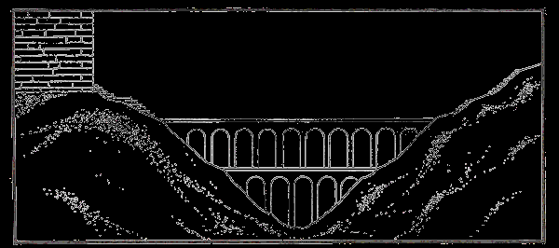
HISTORY
Access to this site was through the eastern gate, also called the Golden Gate. The valley between Mount of Olives (crucifixion sight) and Mount Moriah (where Jerusalem is situated) was called the Kidron Valley or Brook. The blood and water from the temple sacrifices would flow down between these two mountains through this Kidron valley also called the Valley of Death. Joining the two mountains was a bridge built for the priests to travel over the Kidron Valley. It was called the Priestly Bridge, the Red Heifer’s Gangway and the Narrow Way, and allowed the priests to travel from one mountain to the other in order for them to perform their sacrificial duties without coming in contact with death from the unclean flow of the Temple.
In Genesis, when Abraham received the Covenant from יהוה, he was told to sacrifice animals. Traditionally they would be cut in half with the halves placed opposite each other so the blood would flow down each side and into the trough between them. The halved animals represented the House of Israel and the House of Judah (Genesis 15: 1-21).

Slide 12
ATONING BLOOD
Mount Moriah represents those who are in Torah and the Mount of Olives represents those people outside Torah. Together they represent the Whole House of Israel (Jeremiah 31:31-33; Hebrews 8:8-10). It is the atoning blood of יהושע symbolised by the red heifer sacrifice, that can break down the barriers within the people and between the two groups to bring healing; thus uniting them as one people under the Kingship of יהושע Ha Mashiach (Hebrews 9:15; Ephesians 2:11-22).
At the time of יהושע’s death a flow of blood similar to the cutting of first covenant was seen with the blood of יהושע’s sacrifice flowing down the other mount, Mount of Olives. יהושע’s one act of faithfulness fulfilled the red heifer sacrifice and literally renewed the Covenant of Abraham, sealing it forever. Renewing the Mosaic and Davidic covenants were also renewed by fulfilling the Abrahamic covenant. יהושע restored His people and made the Covenant as new again for us to walk in (Jeremiah 31:33-34; Hebrew 8:8-10; Matthew 10:8; 15:24; Romans 11:25-26; Ezekiel 37:15-28).

Slide 13
NARROW WAY
It was this priestly bridge, called the Narrow Way or Gangway that יהושע crossed as He rode into Jerusalem on a donkey, five days before the Passover to be our Passover Lamb. We are told that all the people held palm branches and waved them, shouting “Hosanna! (Hebrew for “Save us!”) Blessed is He who comes in the Name of יהוה! Blessed is the King of Israel,” thus fulfilling Psalm 118:25-26 and Zechariah 9:9 (John 12:12-15). It was along this bridge that the people proclaimed Messiah יהושע, King of Israel. And it was this same bridge that carried יהושע to His death on our behalf a few days later as the final fulfilment of the red heifer requirement.
“Enter in through the narrow gate! Because the gate is wide – and the way is broad – that leads to destruction, and there are many who enter in through it. “Because the gate is narrow and the way is hard pressed which leads to life, and there are few who find it. (Matthew 7:13-14)

Slide 14
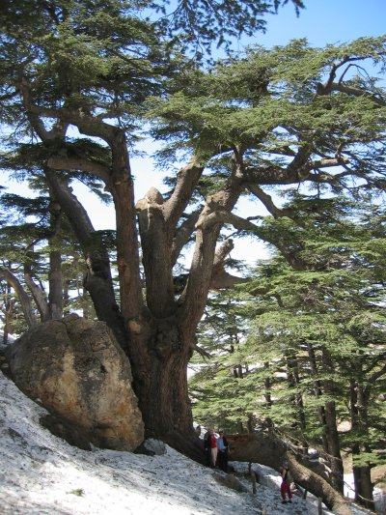
NUMBERS 19:6
‘And the priest shall take cedar wood and hyssop and scarlet, and throw them into the midst of the fire burning the heifer.
Cedar - represents strength or pride. Our pride makes us think we are long lasting, indestructible and above the Law.
The cedar of Lebanon that was most widely referred to when the word erez (cedar) is used in Scripture. The average height of such cedars is about eighty-five feet, though some have measured over a hundred feet, and the circumference may reach forty feet. It is also common for this tree to spread its roots among the rocks, thus securing a stronghold. There is a particular oil in the cedar that prevents destruction by dry rot and insects. Scriptural references for cedar use in connection with the Temple is in 1 Kings 6:15 and 18, where cedar was used inside the Temple and 1 Kings 7:12, where it was used outside the Temple. Out of all the furniture in the Temple only the Altar of Incense was made of cedar (1 Kings 6:20).
Cedrus libani is an evergreen coniferous tree growing up to 40 m (130 ft) tall, with a trunk up to 2.5 m (8 ft 2 in) in diameter.

Slide 15
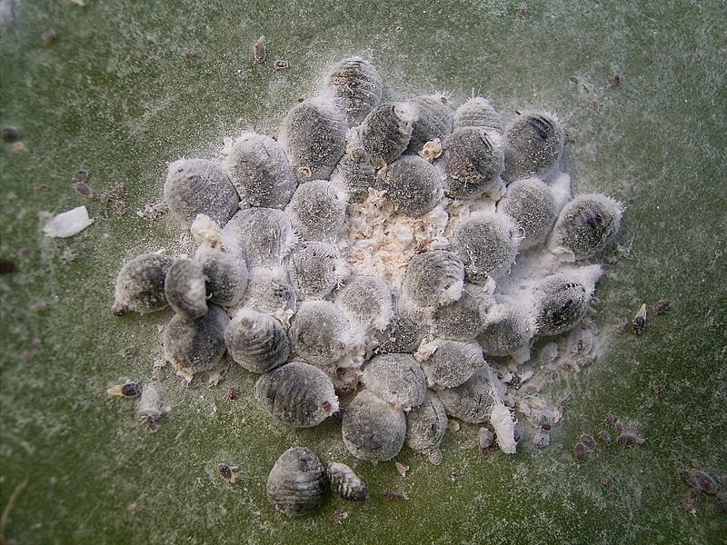
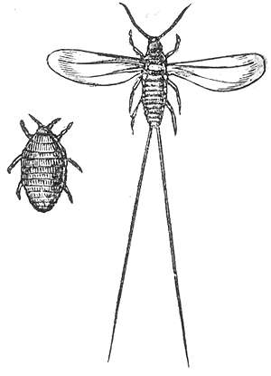
NUMBERS 19:6
Scarlet thread: represents יהושע’s blood. It refers to the dye obtained from the eggs of the female cochineal scale that attached itself to the kermes oak tree. The word towla (Strong’s # 8438) is Hebrew for scarlet, worm or crimson. When the female “scarlet worm” was ready to give birth to her young, she would attach her body to the trunk of a tree, fixing herself so firmly and permanently that she would never leave again. The eggs deposited beneath her body were thus protected until the larvae were hatched and able to enter their own life cycle. As the mother died, the crimson fluid stained the wood surrounding her body, acting as a covering. From the dead bodies of such female scarlet worms the commercial scarlet dyes of antiquity were extracted. Some 70,000 cochineal insects are required to manufacture a single pound of the dye. It is used in such purification ceremonies as the cleansing of the leper (Leviticus 14:4,6), the leprous house (Leviticus 14:49,52) and for general ceremonial uncleanness (Number 19:6). The towla dye was the color of blood and would be a natural symbol.

Slide 16
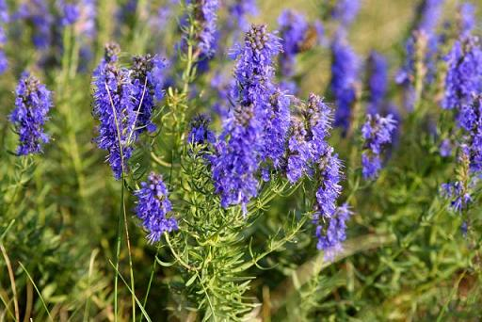
NUMBERS 19:6
Hyssop represents humility. The word occurs ten times, primarily in the Five Books of Moses. Hyssop is a small plant that can grow on walls. Hyssop was used in purification ceremonies. In Exodus, hyssop functioned as a brush for the Israelites to apply blood to the doorposts and lintels of their homes. In Leviticus 14:4-6, hyssop, along with cedar wood and scarlet thread, was used in a purification ceremony for a man cured of leprosy and from an outbreak of mildew. King David said, "Cleanse me with hyssop, and I will be clean" (Psalms 51:7). Cedar and hyssop, represent the most magnificent tree and the most insignificant bush.
Cedar, hyssop and scarlet thread are all symbols of the Messiah dying on the tree for our sins.

Slide 17
NUMBERS 19:11
Verse 11 “He who touches the dead of any human being is unclean for seven days”. The word “touches” is “nagah”, Strong’s #5060 and means “touch”, “to reach for”, “to violate”, “to touch the heart of”. The “desire to touch”, is a conscious decision.
The word for “dead” used in these verses is “muwth”, Strong’s #4191, meaning “to be dead”, “brought to naught” or “to fail” (as in your heart fails you), death is the result of sin, of “heart failure”. “Blessed are the clean in heart, because they shall see Elohim. (Matthew 5:8) Draw near to Elohim and He shall draw near to you. Cleanse hands, sinners. And cleanse the hearts, you double-minded! (James 4:8)
“any human being”, some translations read “body of a man”. The phrase here is actually “nefesh adam” or “being of a man”. The verse then says this person is “unclean” (tame`) for seven days.
Anyone who reaches out to touch that which is “death to one’s nefesh (or being) is unclean”. If you reach out to sin, you are a sinner. You are unclean.

Slide 18
NUMBERS 19:12-13
‘He is to cleanse himself with the water on the third day, and on the seventh day he is clean. (Numbers 19:12)
If we accept יהושע’s victory over death on the third day. If we wash ourselves with the “water” of the third day, we will be declared clean on the seventh day. That day represents the first resurrection which occurs when Mashiach comes on the seventh day, Yom Shabbat.
If we do not accept יהושע, we are not clean. In fact, we are cut off. Here in verse 13 it says that the “water for uncleanness” was not sprinkled on him. The phrase here is “mayim niddah” or “waters for separation” (impurity).
If we do not cleanse ourselves, we defile the Dwelling Place of Elohim. What, or who, is the “Dwelling Place” or “Mishkan” of Elohim? In the absence of the Temple, we ourselves are. He won’t dwell in an unclean Tabernacle.

Slide 19
NUMBERS 19:14-15
‘This is the Torah when a man dies in a tent: All who come into the tent and all who are in the tent are unclean for seven days, and every open vessel which has no cover fastened on it, is unclean.
“Tent”, “ohel” - Strong’s #168, meaning “Tent”, “Dwelling Place” or “Tabernacle”. Any one who “reaches out toward death” in the “Meeting Place” makes all who are in the Meeting Place unclean. Example: While in the “church”, we’ve all “taken away” and “added to” His Torah of Truth.
“every open vessel”, which is “pethach kelee”, which can also be read as “engraved armor”, marked by Elohim.
“no cover fastened”, which is “tsamid patheil” or “bracelet and thread”.
Those who have no “covering”, not “marked” or have no “engraved armor” or “bracelet” are “unclean” forever. The verse implies that our covering, our armor, is “bound” or “fastened” to us. Paul called himself a “bondservant” of Elohim, bound in “armor” and “bracelets”, or protection and bridal adornments.

Slide 20
NUMBERS 19:16
‘Anyone in the open field who touches someone slain by a sword or who has died, or a bone of a man, or a grave, is unclean for seven days.
“one slain” is “chalal”, or “one profaned”, the word for “sword” is “kereb”, or “stone cutter‟s tool”
“open” is “panim” or “face” and the word for “field” is “sadeh” or “open land”.
“who has died”, which is “muwth” or one who has “failed” or is “dead”.
“a bone of a man”, which is “etsem adam” or “substance of a man”.
“grave”, or “qeber”, which is “sepulcher” or “tomb”, as opposed to “she’ol” which is “grave”.
Anyone who reaches for one that is profaned by the sword in the open, or the dead (as sinners), or the substance of men (earthly riches), or the tomb (to live among the dead), shall be unclean seven days.

Slide 21
NUMBERS 19:17-18
‘And for the unclean being they shall take some of the ashes of the heifer burnt for cleansing from sin, and running water shall be put on them in a vessel. ‘And a clean man shall take hyssop and dip it in the water, and shall sprinkle it on the tent, and on all the vessels, and on the beings who were there, or on the one who touched a bone, or the slain, or the dead, or a grave.
“ashes” is “aphar”, Strong’s #6083 also meaning “dust” same as.
And יהוה Elohim formed the man out of dust from the ground, and breathed into his nostrils breath of life. And the man became a living being. (Genesis 2:7)
“And I shall make your seed as the dust of the earth, so that, if a man could count the dust of the earth, then your seed also could be counted. (Genesis 13:16)
We have יהושע as the Son of Adam (from the dust) and by His sacrifice, we become part of Avraham’s seed, the “dust of the earth” who cannot be counted.

Slide 22
NUMBERS 19:17
“running water”, “chai mayim” or “living water
.. “If you knew the gift of Elohim, and who it is who says to you, ‘Give Me to drink,’ you would have asked Him, and He would have given you living water.” (John 4:9-10)
And on the last day, the great day of the festival, יהושע stood and cried out, saying, “If anyone thirsts, let him come to Me, and let him who believes in Me drink. “As the Scripture said, out of His innermost shall flow rivers of living water.” (John 7:37-38)
“Be amazed, O heavens, at this, and be frightened, be utterly dried up,” declares יהוה. “For My people have done two evils: they have forsaken Me, the fountain of living waters, to hew out for themselves cisterns, cracked cisterns, which do not hold water. (Jeremiah 2:12-13)
O יהוה, the expectation of Yisra’ĕl, all who forsake You are put to shame. “Those who depart from Me shall be written in the earth, because they have forsaken יהוה, the fountain of living waters.” (Jeremiah 17:13)

Slide 23
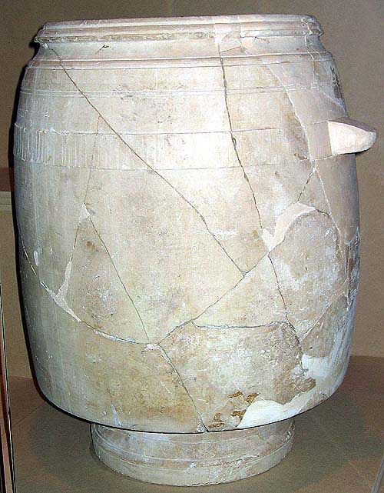
PURIFICATION JARS
For an unclean (tzarat) person, ashes from the red heifer, the burnt offering of purification, were put into a jar, and fresh living water was poured over them. Then a man who was ceremonially clean would take some hyssop, dip it in the water and sprinkle the tent and all the furnishings, as well as the people who were there. But if a person who was unclean did not purify himself on the third and seventh day, he was cut off from the community, because he had defiled the sanctuary of YHVH; the water of cleansing had not been sprinkled on him, and he was unclean.
His mother said to the servants, “Do whatever He says to you.” And there were six stone water-jugs standing there, according to the mode of cleansing of the Yehuḏim, each holding two or three measures. יהושע said to them, “Fill the water-jugs with water.” ..(John 2:5-9)

Slide 24
NUMBERS 20:1-13
And the children of Yisra’ĕl, all the congregation, came into the Wilderness of Tsin in the first month, and the people stayed in Qaḏĕsh. And Miryam died there and was buried there. Now there was no water for the congregation and they assembled against Mosheh and against Aharon. And the people contended with Mosheh and spoke, saying, “If only we had died when our brothers died before יהוה! ...“And why have you brought us up out of Mitsrayim, ...“Take the rod and assemble the congregation, you and your brother Aharon. And you shall speak to the rock before their eyes, and it shall give its water. .. And Mosheh took the rod from before יהוה as He commanded him. .. And he said to them, “Hear now, you rebels, shall we bring water for you out of this rock?” Then Mosheh lifted his hand and struck the rock twice with his rod. .. But יהוה spoke to Mosheh and to Aharon, “Because you did not believe Me, to set Me apart in the eyes of the children of Yisra’ĕl, therefore you do not bring this assembly into the land which I have given them.” These were the waters of Meriḇah, because the children of Yisra’ĕl contended with יהוה, and He was set apart among them.

Slide 25
WHY THE DIFFERENCE
...assemble the congregation, you and your brother Aharon. And you shall speak to the rock before their eyes, and it shall give its water. And you shall bring water for them out of the rock and give drink to the congregation and their livestock.” (Numbers 20:8)
In His reaction to the people’s complaint, the Almighty appears very merciful and full of love. But why does their complaint stir Moshe to anger and יהוה to compassion? To us it seems that Moshe’s response was justified, since they are repeating a former complaint. So then, what explains יהוה’s empathetic response? The key to understanding the story is timing:
This is not the same generation that uttered the first complaint.
This is a generation that has never known slavery, are free people, and looking towards the Promised Land.
They are in the beginning of the 40th year and they are eager to enter!
They are in fact at Kadesh, a city very close to the Promised Land of Israel.

Slide 26
THE WORDS
The complaints of the 1st and 2nd generations sound the same, but the intentions are not at all alike. In Exodus, their complaint ends with the question:
...“Why did you bring us out of Mitsrayim, to kill us and our children and our livestock with thirst?” (Exodus 17:3)
The first generation would have rather stayed in Egypt then followed their deliverer into the wilderness, a statement made many times. The complaint of the 2nd generation can be seen in two parts:
“Why have you brought up the assembly of יהוה into this wilderness, that we and our livestock should die here? (Numbers 20:4)
There is nothing in this first part of the complaint that expresses a desire to return to Egypt. They simply want to know why they have been brought into “this wilderness” and not into the Promised Land.
“And why have you brought us up out of Mitsrayim, to bring us to this evil place? – not a place of grain or figs or vines or pomegranates, and there is no water to drink.” (Numbers 20:5)
Again, they are not expressing a desire to be in Egypt, but instead contrasting this desert location (this evil place) with the land of Israel.

Slide 27
THE COMPLAINT
They do not even complain immediately about their thirst; first they point to the lack of grain, figs, vines, and pomegranates (description of the Land of Israel). As an afterthought, they mention the lack of water. They desire with all their heart to enter the Land. They have become very impatient. Our gracious Abba understands their feelings and therefore commands that their needs be taken care of. Moshe and Aaron, however, judge the nation based on the previous generation’s attitude and therefore see them as “rebels”. QUESTION
Are we a generation who is eager to enter the Promised Land? Do we find ourselves perched at the location of Kadesh?
Have we lost the slave mentality of Egypt?
Do we trust that the Holy One of Israel is actually preparing to take us into the Land?
Do we complain every time we feel our needs are not being provided for?
Do we long for the simple life of Egypt (this world) over the Promised Land?

Slide 28
QADESH AND MIRYAM
“Qadesh” or “Set-apart”, “Holy” The Israelites were in a “Set-apart place”. This was also the place where the rebellion of Korach took place and where the Ten Spies returned and gave the evil report and Israel chose to refuse to enter the Land that Elohim gave them as their inheritance.
It was here that Miryam dies. Now, we know that Miryam was a prophetess from Exodus 15:20. But, her name means “rebellious” or “contemptuous”. In fact, her name is made up of two root words; “Mir” (from “mar”) which means “bitter” and “yam” which is “sea” or “large body of water”. Her name is literally “bitter water” or “contemptuous water”.
The rabbis point out that since Moshe was instructed to strike the rock, in Rephidim, in the Wilderness of Sinai and water came forth for them; that they never lacked water in the wilderness, until Miryam’s death, 38 years later.

Slide 29
MIRYAM’S WELL
The Mishnah teaches that because of her merit, the well followed them throughout the wilderness for all those years. Rabbi Chaim Richman ends his Torah commentary this week by saying,
“Fortunately for Israel, the loss of Miryam’s well was only temporary, and it would continue to follow Israel throughout the duration of its desert sojourn and eventually enter with the people into the land, where it remains until this day. Miriam's well continues to be a source both of physical sustenance and spiritual nourishment for Israel. Israel's main water sources are hidden underground, many of which have yet to be rediscovered in modern times. The people of Israel today are reclaiming these well springs of life-giving water and Torah knowledge. Miriam's protective legacy lives today, proving, like the red heifer, the predomination of life over death, and like the red heifer, providing the keys to the rebuilding of the Holy Temple and the resumption of the Divine service: „They shall neither harm nor destroy on all My holy mount, for the land shall be full of knowledge of the L-rd as water covers the sea bed.‟" (Isaiah 11:9)

Slide 30
DAVID AND PAUL
Slaughtering and meal offering You did not desire; You have opened my ears; Burnt offering and sin offering You did not ask for. Then I said, “See, I have come; In the scroll of the Book it is prescribed for me. I have delighted to do Your pleasure, O my Elohim, And Your Torah is within my heart.” I have proclaimed the good news of righteousness, In the great assembly; See, I do not restrain my lips, O יהוה, You know. (Psalms 40:6-9)
For I do not wish you to be ignorant, brothers, that all our fathers were under the cloud, and all passed through the sea, and all were immersed into Mosheh in the cloud and in the sea, and all ate the same spiritual food, and all drank the same spiritual drink. For they drank of that spiritual Rock that followed, and the Rock was Messiah.
(1 Corinthians 10:1-4)
Paul takes it right back to this idea of the “water”, “mayim” or “knowledge” of HaShem’s Word which comes to us by Yahshua.

Slide 31
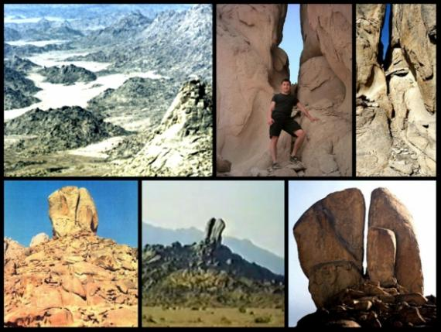
PLACE OF CONTENTION
Adonai refers to this embattled water as “the waters of Meribah” in verse 13.
“Meribah” means “contention” or “strife”. The picture here is really simple. In the flesh, you have people that need water to survive in the “wilderness”, the “dry place”, the “sterile place”. “Water” or “mayim” represents the “knowledge” or “wisdom” of HaShem’s Word. The Zohar teaches that just as the physical waters above and below were poured forth at their loosening by Elohim in the 600th year of Noach, in the 6,000th year, the waters of Elohim (the knowledge or the wisdom of His Word) will pour forth in preparation of Mashiach’s coming.
There’s a message for all of us. For the “Qahal”, the “congregation”; don’t contend with יהוה, or His servants that are here to teach you about His “Mayim”….. the “water of the Word”. And for the “leaders”, the “nagadim”; don’t give in to “contention” by getting overcome with anger.

Slide 32
THE ROLE OF A SHEPHERD
thus you shall bring water (v’hishikita) for them out of the rock, and give drink to the congregation and their animals.“ Numbers 20:8
יהוה commands Moshe and Aharon to “v’hishikita”, which literally means “to water,” in the sense that a shepherd waters his flock. Moshe has played the shepherd role before when he helped the daughters of Yitro and their sheep:
but the shepherds came and drove them away. Then Mosheh stood up and came to their rescue, and watered their flock. (Exodus 2:17)
The role of a shepherd taking care of the flock was usually understood by Moshe to be necessary in leading the children of Israel. We see this later in Moshe’s request toיהוה :
And Mosheh spoke to יהוה, saying, “Let יהוה, the Elohim of the spirits of all flesh, appoint a man over the congregation, who goes out before them and comes in before them, who leads them out and brings them in, so that the congregation of יהוה be not like sheep without a shepherd.” (Numbers 27:15-17)

Slide 33
MOSHE AND AARON
Moshe and Aaron “lost it”. The command that יהוה gave Moshe in Leviticus was intended for Moshe to practice the leadership style of shepherding …the one who waters his flock from the rock. The problem was, when יהוה specifically requested that Moshe should be the one to “give drink to the congregation and their animals,” it is instead reported that “the congregation and their animals drank” (as if they did it independently of Moshe).
Moshe was instructed to take Aaron's rod and “speak to”, “dabar tom”, the “Rock”, “Selah” and “it shall give its water (mayim)”. In the wilderness, that meant literal water. But, in our time right now, it means also the knowledge and wisdom of the Living Water, the Word of Elohim. In Moshe’s and Aaron's anger, over yet another contention, they belittled the people (calling them all rebels), struck the Rock (not once, but twice) and did not give the glory, or esteem, for the water to יהוה.
Paul warns in Ephesians 4:26; “Be angry, but do not sin.” Moshe’s and Aaron's sin caused both of them to be forbidden to lead Israel into the Land of their inheritance. That’s a high price to pay for a few minutes of consuming anger.

Slide 34
NOT SETTING HIM APART
Moshe’s sin, then, is seen as a failure in his role as a shepherd. Now, the Almighty repeatedly refers to Moshe’s sin as that of “not sanctifying Him” in the “eyes of the children of Israel”:
But יהוה spoke to Mosheh and to Aharon, “Because you did not believe Me, to set Me apart in the eyes of the children of Yisra’ĕl, therefore you do not bring this assembly into the land which I have given them.” (Numbers 20:12)
because you rebelled against My mouth in the Wilderness of Tsin, in the strife of the congregation, to set Me apart at the waters before their eyes.”... (Numbers 27:14)
because you trespassed against Me in the midst of the children of Yisra’ĕl at the waters of Meriḇah Qaḏĕsh, in the Wilderness of Tsin, because you did not set Me apart in the midst of the children of Yisra’ĕl. (Deuteronomy 32:51)

Slide 35
NOTES
While יהוה sometimes lists other reasons such as lacking “trust” (Numbers 20:12), “trespassing against Him” (Deuteronomy 32:51), and even labelling him as a “rebel” (Numbers 27:14), each of these are listed within the context of not “setting Him apart in the eyes of the children of Israel.”
By not filling his role as a shepherd who waters His flock, Moshe has failed in “setting apart” the Name of the Almighty.
We can also turn that around and say that “to set Him apart” is to fulfil the role of a shepherd. This then explains the fate of Moshe and Aaron.

Slide 36
THE STAFF
The “staff” that “strikes the rock” also provides us with interesting insights. This “staff” has already been labelled as a “sign against the rebels”:
And יהוה said to Mosheh, “Bring Aharon’s rod back before the Witness, to be kept as a sign against the rebels, so that you put an end to their grumblings against Me, lest they die.” (Numbers 17:10)
This could explain why when יהוה told Moshe to “take the staff from before יהוה” (Numbers 20:9) because this was not a situation requiring the staff against the Israelites as “rebels”. This particular “staff” was the dry stick of Aaron that had sprung to life after all the incidents following the rebellion of Korach:
... Mosheh went into the Tent of the Witness and saw that the rod of Aharon, of the house of Lĕwi, had budded, and brought forth buds, and blossomed and bore ripe almonds. (Numbers 17:8)
This “staff,” was to be a “sign” to the people that יהוה had bestowed leadership through Moshe and Aaron. It was this “staff” representing life, which Moshe was to take from “before יהוה” and hold in his hand while “speaking to the rock.”

Slide 37
THE STAFF con’t
And יהוה said to Mosheh, “Pass over before the people, and take with you some of the elders of Yisra’ĕl. And take in your hand your rod with which you smote the river, and go. “.. And you shall smite the rock, and water shall come out of it, and the people shall drink.” (Exodus 17:5-6)
This first “staff” was used as a show of force during the plagues of Egypt.
And יהוה spoke to Mosheh and to Aharon, saying, ..‘Take your rod and throw it before Pharaoh, and let it become a serpent.’ .. And they, the magicians of Mitsrayim, also did so with their magic. And they, each one, threw down his rod, and they became serpents. But the rod of Aharon swallowed up their rods. (Exodus 7:8-12)
Following this incident, the “staff” is used to chastise Pharaoh for his disobedience to יהוה’s word and to inform him that “by this you will know that I am יהוה ”:
“Go to Pharaoh in the morning, .. take in your hand the rod which was turned into a serpent. ..Thus said יהוה, “By this you know that I am יהוה. See, I am striking the waters which are in the river with the rod that is in my hand, and they shall be turned to blood, (Exodus 7:15-17)

Slide 38
SYMBOL OF THE STAFF
This “staff” symbolizes “knowing” the Almighty. It represents the defeat of Pharaoh and the striking of the very life force of Egypt (this world). By commanding Moshe to use this “staff”,יהוה wanted the demonstration of the water pouring from the rock in Exodus to link with the defeat of Pharaoh and his world system. Centuries later, the Rock (יהושע) was struck and blood pours forth, just as it did in Egypt. Then “you shall know that I am יהוה
Then יהושע said to them, “All of you shall stumble in Me this night, for it has been written, ‘I shall strike the Shepherd, and the sheep of the flock shall be scattered.”(Matthew 26:31)
But one of the soldiers pierced His side with a spear, and instantly blood and water came out. And he who has seen has witnessed, and his witness is true. And he knows that he is speaking the truth, in order that you might believe. (John 19:34-35)
People coming out of Egypt need to understand redemption and the defeat of the evil forces. This was accomplished through the symbolism of the first “staff.” A picture that pointed to יהושע.

Slide 39
THE ROCK - יהושע
“Come out of Baḇel! Flee from the Chaldeans! Declare this with a voice of singing, proclaim it, send it out to the end of the earth! Say, ‘יהוה has redeemed His servant Yaʽaqoḇ!’ ” And they did not thirst when He led them through the deserts; He caused waters from a rock to flow for them; He split the rock, and waters gushed out. (Isaiah 48:20-21)
The event at the “rock” is intended to point to a new stage in the people’s spiritual development. Previously, the 1st generation learned the importance of “knowing Him” through the miracle of “striking the rock.”
and all drank the same spiritual drink. For they drank of that spiritual Rock that followed, and the Rock was Messiah. (1 Corinthians 10:4)
In the book of Numbers, יהוה intends for the people to understand words, through the example of Moshe and Aaron as the sprouting staff is used in combination with speaking (words) to the life giving rock. This is, what it means to “set the Almighty apart…to be set apart through His Word :
“Set them apart in Your truth – Your Word is truth. (John 17:17)

Slide 40
THE ROCK - יהושע
Without realizing it, Moshe undermines the lessons the new generation needed to learn. By striking the rock again Moshe was going against the Word of God and also against the prophetic significance. The second coming of the Rock (יהושע) would be signified by Him been him ruling and reigning with us for eternity.
It was time to move forward and understand the importance of living life according to the Word (Torah). Unfortunately, the shepherd Moshe, sent the wrong message. By striking the rock instead of speaking words, He did not “SET APART” the Name of יהוה.
Who is the one who overcomes the world but he who believes that יהושע is the Son of Elohim? This is the One that came by water and blood: יהושע Messiah, not only by water, but by water and blood. And it is the Spirit who bears witness, because the Spirit is the Truth. Because there are three who bear witness: the Spirit, and the water, and the blood. And the three are in agreement. (1 John 5:5-8)

Slide 41
SPEAK TO THE ROCK - יהושע
יהוה wants to strengthen our faith through the power of the Word. The Word itself is much more powerful than miracles which one may witness. Our Messiah is the Word made flesh. He lived the Word perfectly:
And the Word became flesh… John 1:14
When יהוה asked Moshe to “speak to the rock before their eyes?” (Numbers 20:8) it was to reveal a new dimension of relationship the Father wants. It is implied here that Moshe and Aaron were to “speak” so that the people could “see” as an example of how. A revisit of a time when יהוה “spoke” in order for the people to “see”:
And all the people saw the thunders, the lightning flashes, the sound of the ram’s horn, and the mountain smoking. And the people saw it, and they trembled and stood at a distance, and said to Mosheh, “You speak with us and we hear, but let not Elohim speak with us, lest we die.” (Exodus 20:18-19)

Slide 42
THE INSTRUCTION
יהוה wanted Moshe and Aaron to exemplify a new instruction by using their “voice” to “speak” to the people. As Exodus 20:18 indicates, the people requested that if Moshe would “speak” it would result in them “hearing” (shema). THIS WAS THE REASON FOR THE INSTRUCTION יהוה GAVE MOSHE in our parasha. If Moshe would have “spoken,” he would have fulfilled Exodus 20:19 and given the people opportunity to “shema!” and learn.
יהושע came as a prophet like Moshe. He “spoke” to us these words of Moshe/Torah, because He is the Good Shepherd who brought “life” (symbolized by the budding staff), and who “sets apart” His people, the area where Moshe fell short:
“.. I have come that they might possess life, and that they might possess it beyond measure. “I am the good shepherd. The good shepherd lays down His life for the sheep. (John 10:10-11)
“And for them I set Myself apart, so that they too might be set apart in truth. (John 17:19)

Slide 43
HEAR AND OBEY
Note: It can also be noted that the second coming will also take place in this valley with יהושע coming through the east gate once again. Now according to our own request on the Mountain (Shemot 20:19), we must “hear” (shema) and obey
And יהושע answered him, “The first of all the commands is, ‘Hear, O Yisra’ĕl, יהוה our Elohim, יהוה is one. ‘And you shall love יהוה your Elohim with all your heart, and with all your being, and with all your mind, and with all your strength.’ This is the first command. (Mark 12:29-30)
“Speaking Words” is still important. “Words” are the food the shepherd offers the sheep. The Good Shepherd asks us to continue in His work:
How then shall they call on Him in whom they have not believed? And how shall they believe in Him of whom they have not heard? And how shall they hear without one proclaiming? And how shall they proclaim if they are not sent? As it has been written, “How pleasant are the feet of those who bring the Good News of peace, who bring the Good News of the good!” However, not all obeyed the Good News. For Yeshayahu says, “יהוה, who has believed our report?” So then belief comes by hearing, and hearing by the word of Elohim. (Romans 10:14-17)

Slide 44
EDOM
And Mosheh sent messengers from Qaḏĕsh to the sovereign of Eḏom. “This is what your brother Yisra’ĕl said, ‘You know all the hardship that has befallen us, that our fathers went down to Mitsrayim, and we dwelt in Mitsrayim a long time, .. ‘And we cried out to יהוה, and He heard our voice and sent the Messenger and brought us up out of Mitsrayim. And see, we are in Qaḏĕsh, a city on the edge of your border. ‘Please let us pass over, through your land. We shall not pass over through fields or vineyards, nor drink water from wells, we shall go along the sovereign’s highway. We shall not turn aside, right or left, until we have passed over your border.’ ” But Eḏom said to him, “You do not pass over through me, lest I come out against you with the sword.” .. And Eḏom came out against them with many men and with a strong hand. So when Eḏom refused to let Yisra’ĕl pass over through his border, Yisra’ĕl turned away from him. (Numbers 20:14-21)
Moshe reminds the king of Edom that they are family, by referring to Esau’s brother Jacob, but, Edom refuses to let them through. Moses did not want to kill his own family.

Slide 45
AARON’S DEATH
And the children of Yisra’ĕl, all the company, departed from Qaḏĕsh and came to Mount Hor. And יהוה spoke to Mosheh and to Aharon in Mount Hor near the border of the land of Eḏom, saying, “Aharon is to be gathered to his people, ..“Take Aharon and Elʽazar his son, and bring them up to Mount Hor, and strip Aharon of his garments and put them on Elʽazar his son, for Aharon is to be gathered to his people and die there.” ... And Aharon died there on the top of the mountain. ..And when all the congregation saw that Aharon was dead, all the house of Yisra’ĕl wept for Aharon, thirty days. (Numbers 20:22-29)
Mount Hor, or “Har Hor” in the Hebrew meaning “Mount Mountain”. Implied meaning “Mountain is my parents”. Aharon was “gathered” back to the rock from which he was hewn, his people. Israel wept for Aharon, thirty days. Thirty is the number of the letter “lamed” which is the “shepherd’s staff”. The rabbis teach that this shows us that a “shepherd” or “priest” connects that which is in heaven to that which is in the earth below.

Slide 46
FIERY SERPENT
And the people spoke against Elohim and against Mosheh, “Why have you brought us up out of Mitsrayim to die in the wilderness? For there is no food and no water, and our being loathes this light bread.” And יהוה sent fiery serpents among the people, and they bit the people. And many of the people of Yisra’ĕl died. Then the people came to Mosheh, and said, “We have sinned, for we have spoken against יהוה and against you. Pray to יהוה to take away the serpents from us.” So Mosheh prayed on behalf of the people. And יהוה said to Mosheh, “Make a fiery serpent, and set it on a pole. And it shall be that everyone who is bitten, when he looks at it, shall live.” (Numbers 21:5-8)
The fiery serpents were a righteous judgment Elohim brought upon Israel for murmuring and unbelief. Israel had “sharpened their tongues like a serpent” Psalm 140:3 and “Their throat is an open tomb, with their tongues they have deceived,” “The poison of adders is under their lips,” (Romans 3:13)
All that do not look to יהושע as saviour will perish

